Slide 1
Regression and
Feature Engineering
Dr. Sourasekhar Banerjee (Ph.D.)

Slide 2
Intended Learning Outcomes
Understand regression methods
Understand gradient descent method
  We mostly focus on how to use them in your research and work
Understand feature engineering methods, and their applications

Slide 3
Machine Learning and its types
Machine Learning
Supervised
Unsupervised
Semi-supervised
Reinforcement
Classification
Regression
Clustering
Self training
Co-training
Consistency Regularization
Graph based
Generative models
Decision Making
Logistic Regression
Naive Bayes
KNN
Decision Tree
SVM
Random Forest
Linear Regression
Support Vector Regression
Lasso Regression
Ridge Regression
Partitioning Clustering
Density-based
Hierarchical
Clustering
Grid-based
Clustering
Model-based
Markov
Decision
process
Q-Learning
Deep Q-Learning
…
…
…
…

Slide 4


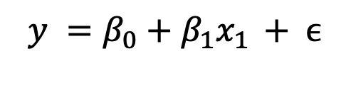

Linear Regression
Simple linear regression.
A statistical method
used to model the relationship between a dependent variable (target) and one or model independent variables (predictors)
fit a linear equation to the observed data.
$$y =β_{0}+β_{1}x_{1 }+ ϵ$$
Multiple-linear regression.
$$y =β_{0}+β_{1}x_{1 }+β_{2}x_{2}+…+β_{n}x_{n}+ ϵ$$
Error
$$x_{1} x_{2}, …, x_{n}$$
Dependable
Variable
Bias
Independent Variables
$$β_{1 }, β_{2}, …, β_{n}$$
Coefficients of the independent variables.

Slide 5
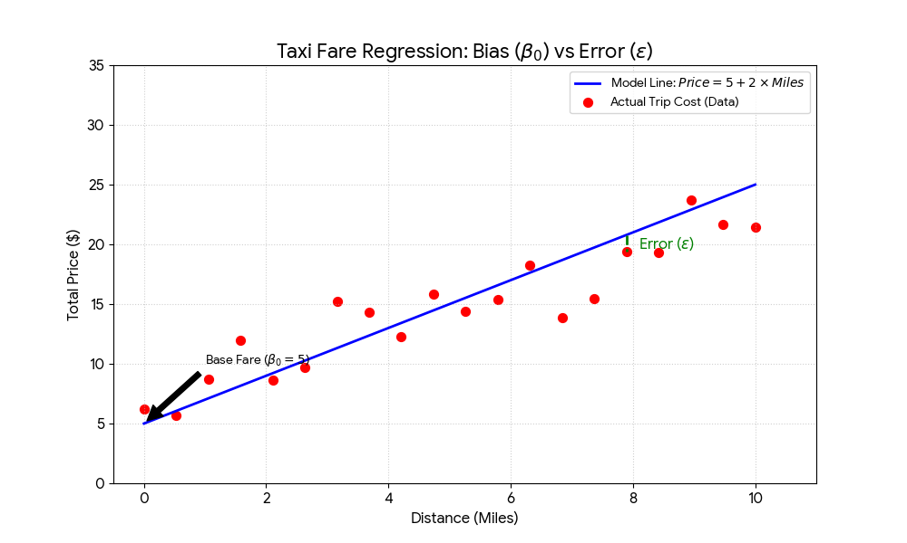
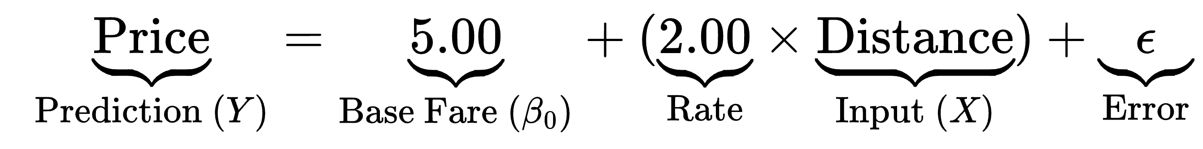
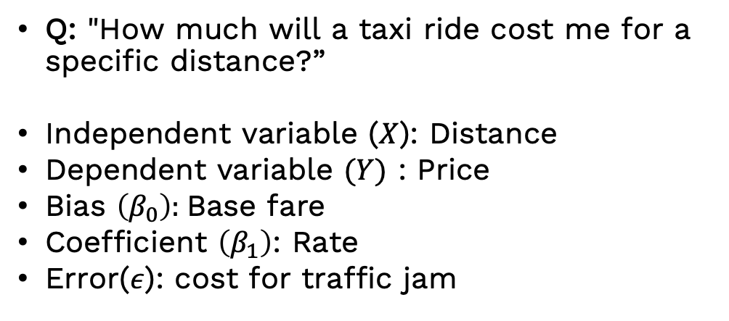
Linear Regression (Example)
Q: "How much will a taxi ride cost me for a specific distance?”
Independent variable ($X$): Distance
Dependent variable $(Y)$ : Price
Bias $\left(β_{0}\right):$Base fare
Coefficient $\left(β_{1}\right)$: Rate
Error($ε$): cost for traffic jam

Slide 6
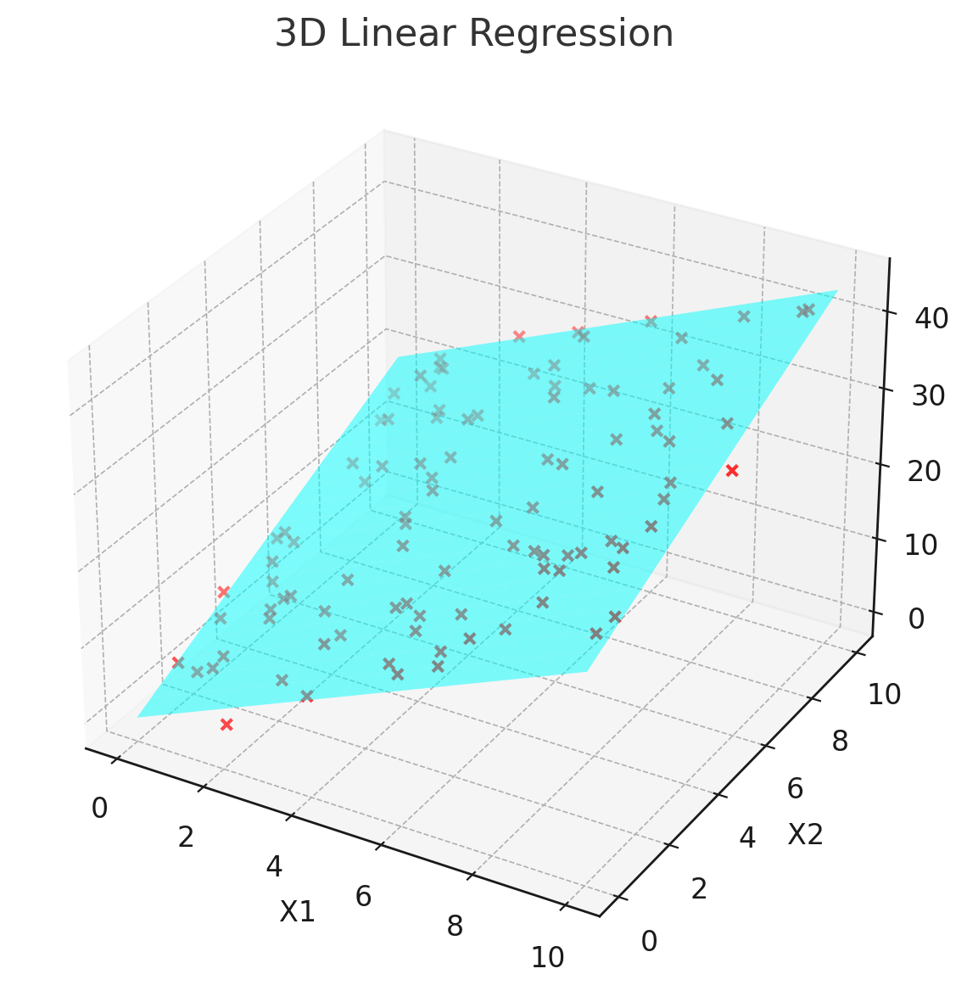
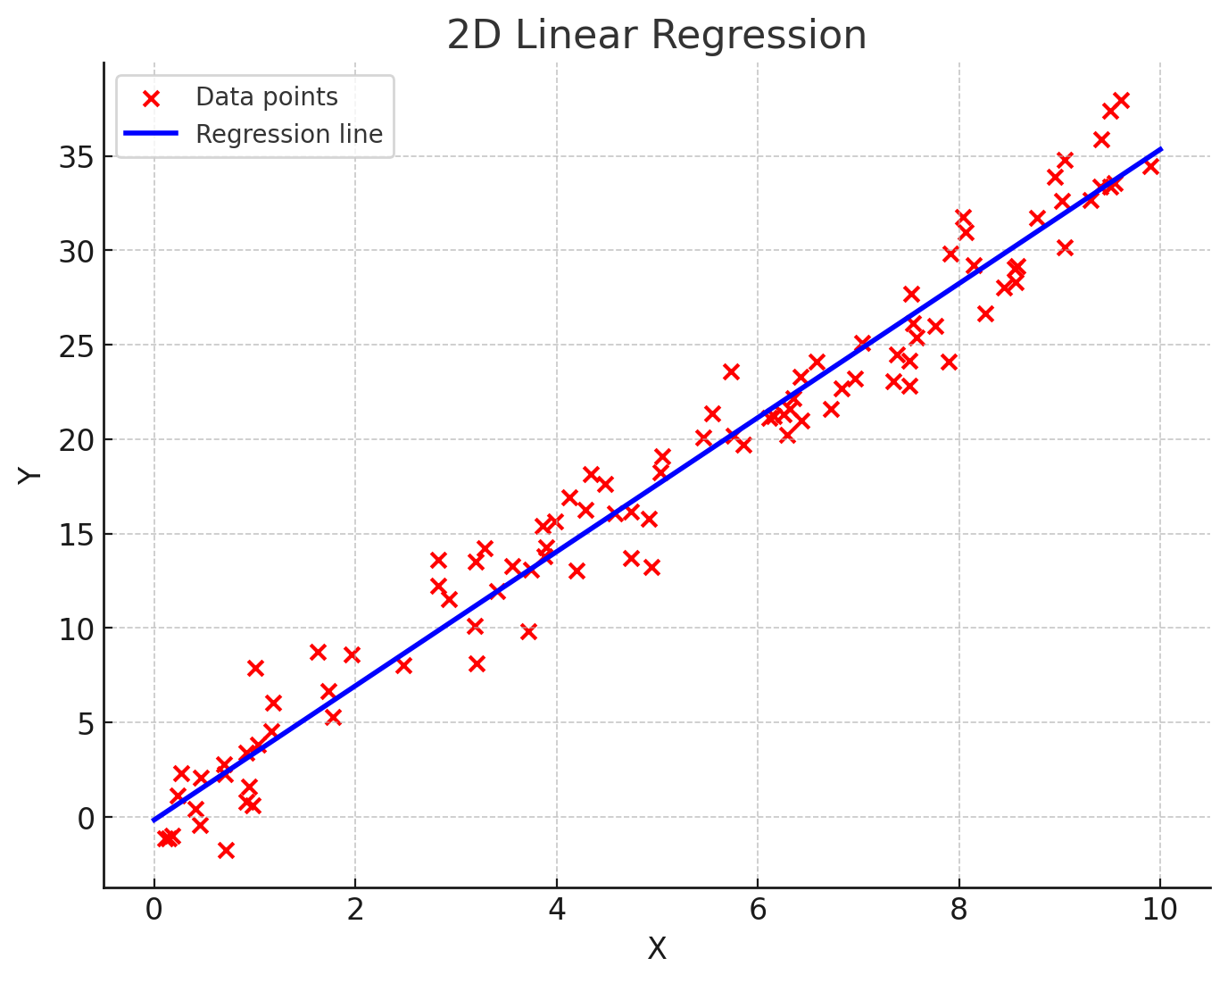
Graphical representation of Linear model
A line in 2-D (one independent variable)
A plane in 3-D (two independent variables)
A hyperplane in d-dimension (d-1 independent variables)

Slide 7
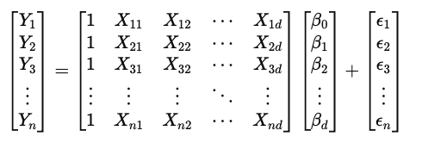
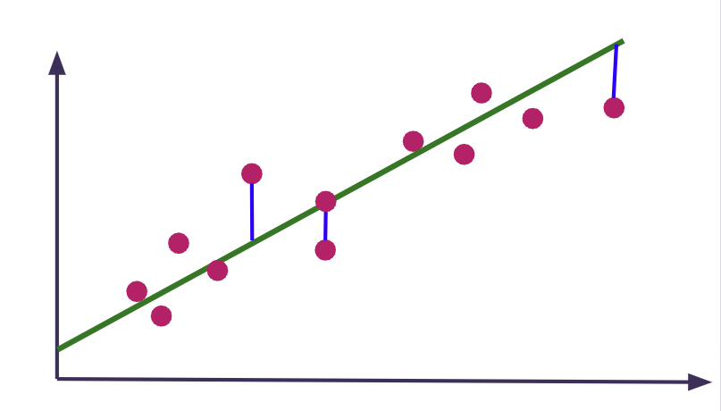
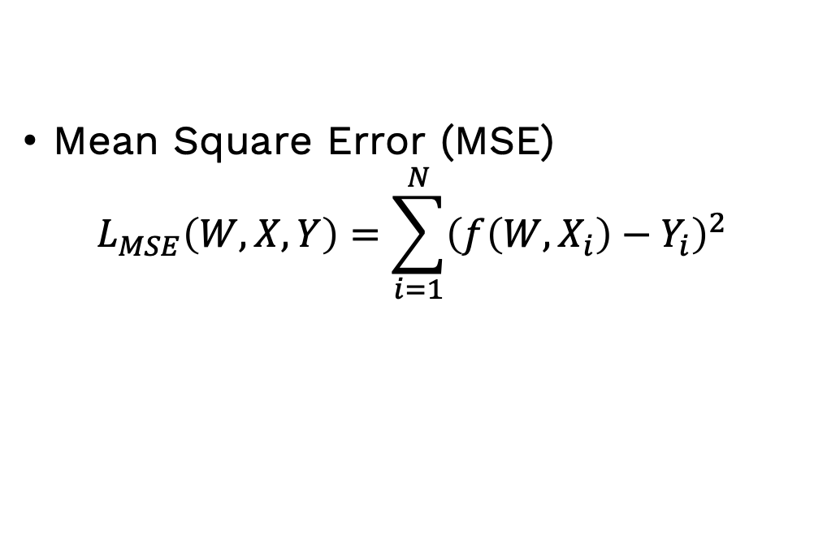

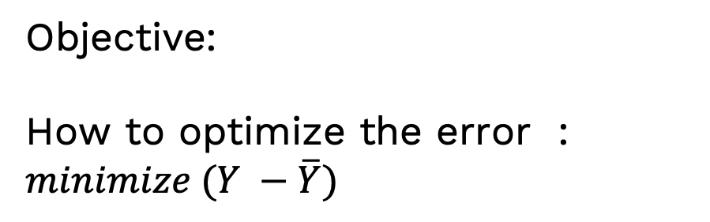
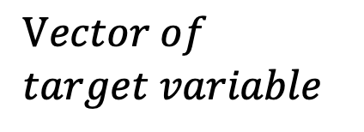


Linear Regression
$$Feature matrix$$
$$Vector of \\ target variable$$
$$Y≈XW$$
$$\overline{Y}=f\left(W,X\right)$$
Weights
Objective:
How to optimize the error : $minimize (Y −\overline{Y})$
Mean Square Error (MSE)
$$L_{MSE}\left(W,X, Y\right)=\sum_{i=1}^{N}{{\left(f\left(W,X_{i}\right)−Y_{i}\right)}^{2}}$$

Slide 8
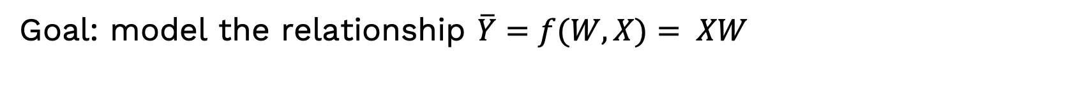
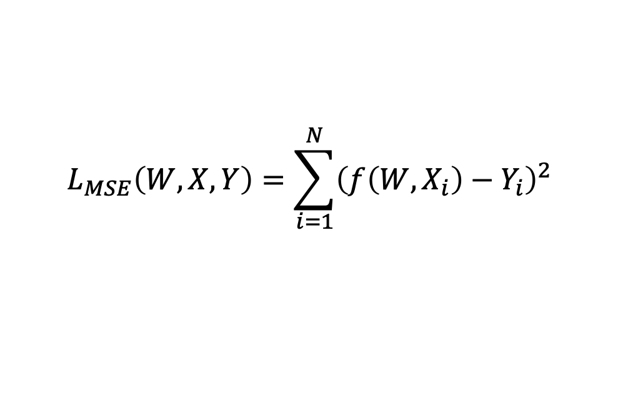

Train a Linear Regression Model
Goal: model the relationship $\overline{Y}=f(W,X)= XW$
Parameter to learn: $W \left(Weights\right) and b \left(bias\right)$
$$L_{MSE}\left(W,X, Y\right)=\sum_{i=1}^{N}{{\left(f\left(W,X_{i}\right)−Y_{i}\right)}^{2}}$$
Optimize Loss function:
Methods
Closed form solution (OLS): Small dataset
Gradient descent: Useful for Large dataset
$$W^{∗}={\left(X^{T}X\right)}^{−1}X^{T}Y$$

Slide 9
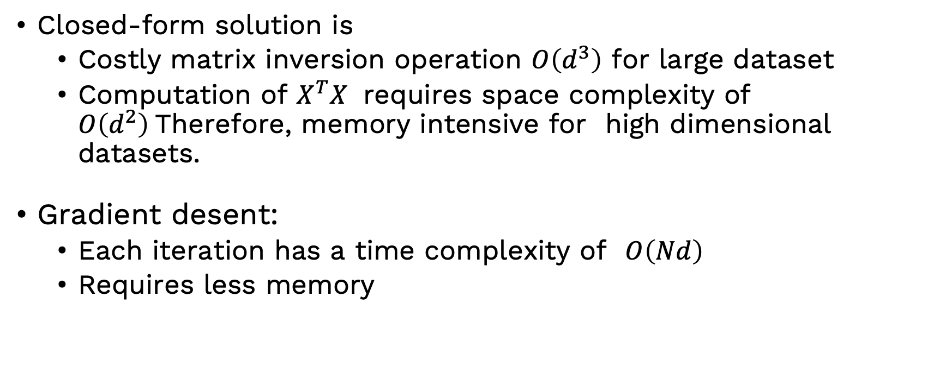
Gradient descent vs closed-form
Closed-form solution is
  Costly matrix inversion operation $O\left(d^{3}\right)$ for large dataset
  Computation of $X^{T}X$ requires space complexity of $O\left(d^{2}\right)$Therefore, memory intensive for high dimensional datasets.
Gradient desent:
  Each iteration has a time complexity of $O\left(Nd\right)$
  Requires less memory

Slide 10
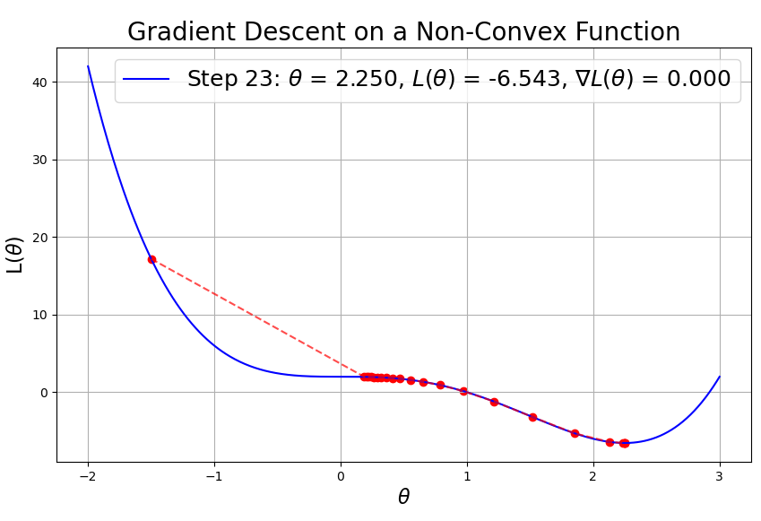
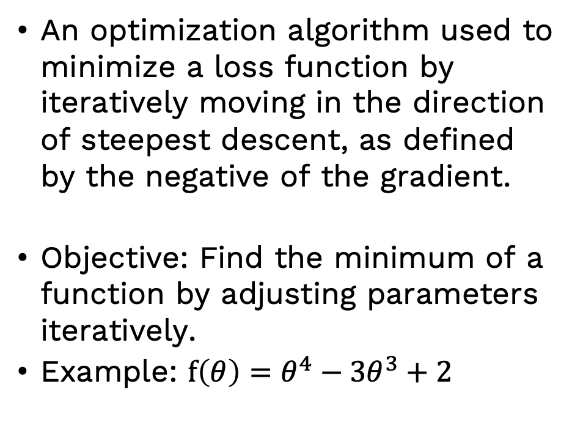
Gradient Descent
An optimization algorithm used to minimize a loss function by iteratively moving in the direction of steepest descent, as defined by the negative of the gradient.
Objective: Find the minimum of a function by adjusting parameters iteratively.
Example: $f\left(θ\right)=θ^{4}−3θ^{3}+2$

Slide 11
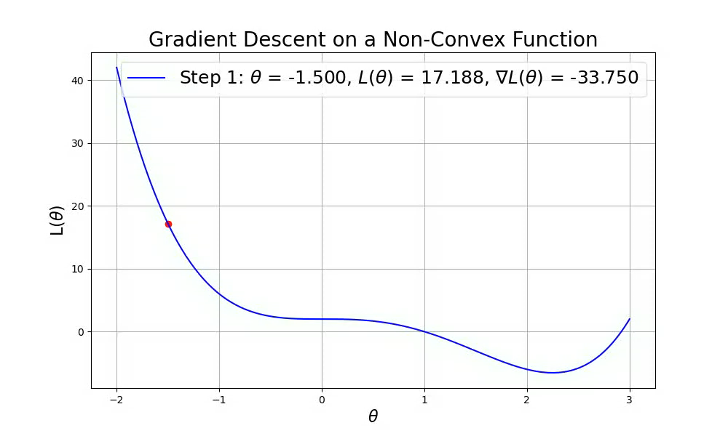
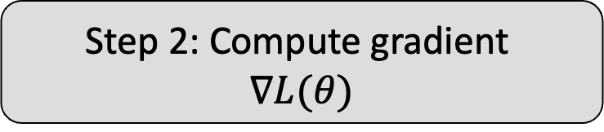
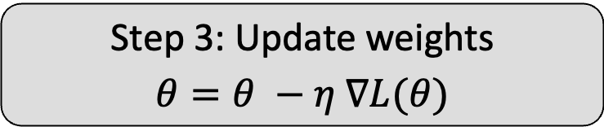
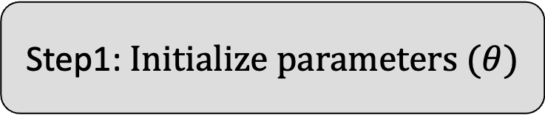
Gradient Descent (Contd.)
Step1: $Initialize parameters (θ)$
Step 2: Compute gradient
$$∇L(θ)$$
Repeat
until Convergence
Step 3: Update weights
$$θ=θ −η ∇L(θ)$$

Slide 12
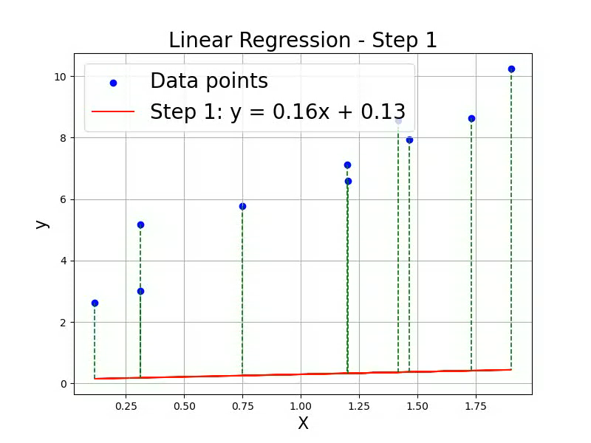
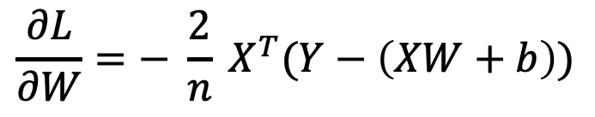
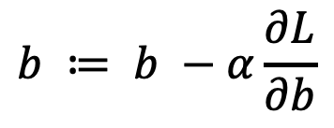
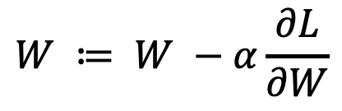
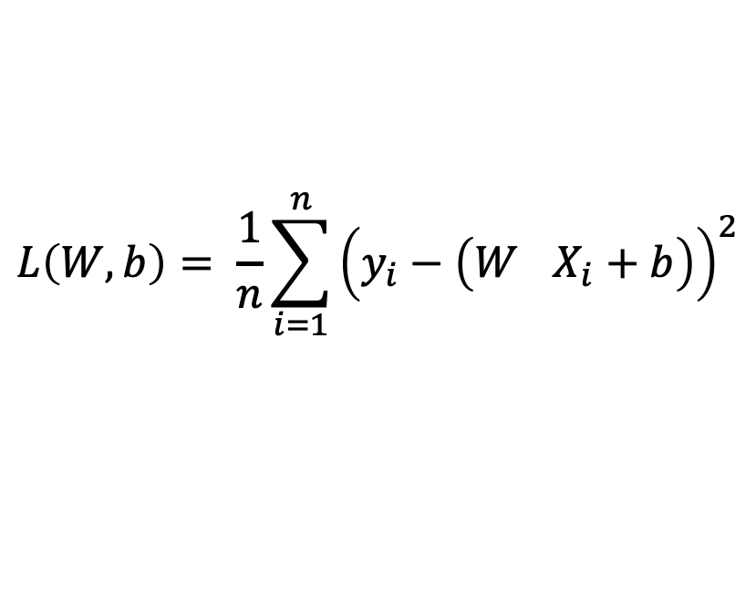
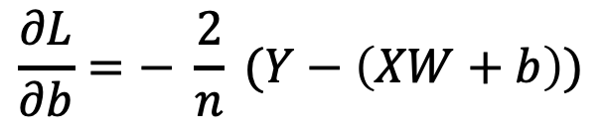
Gradient Descent based Linear Regression
Initialize weights and bias randomly
Define Loss Function (E.g., MSE)
$$L\left(W,b\right)= \frac{1}{n}\sum_{i=1}^{n}{{\left(y_{i}−\left(W^{}X_{i}+b\right)\right)}^{2}}$$
$$W ≔ W −α\frac{∂L}{∂W}$$
Update W and b
$$b ≔ b −α\frac{∂L}{∂b}$$
$$\frac{∂L}{∂W}=− \frac{2}{n} X^{T}(Y−\left(XW+b\right))$$
Gradients
$$\frac{∂L}{∂b}=− \frac{2}{n} (Y−\left(XW+b\right))$$

Slide 13
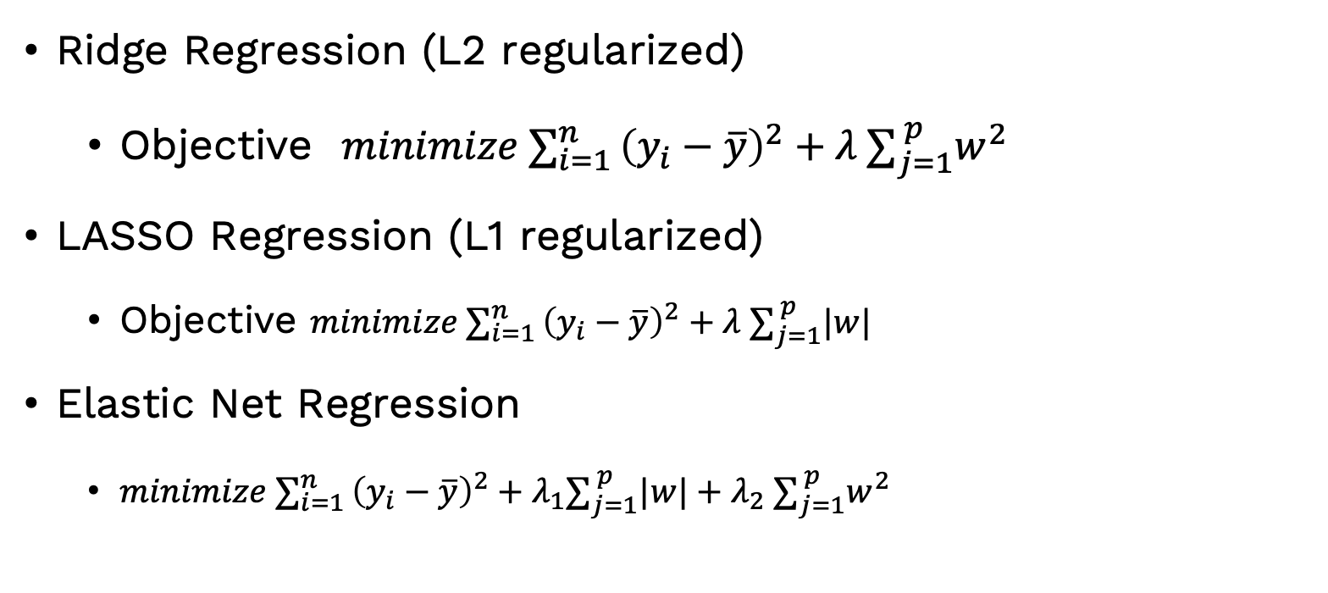
OtherTypes of Linear Regression
Ridge Regression (L2 regularized)
  Objective $minimize ∑_{i=1 }^{n}{\left(y_{i}−\overline{y}\right)}^{2}+{λ ∑}_{j=1}^{ p}w^{2}$
LASSO Regression (L1 regularized)
  Objective $minimize ∑_{i=1 }^{n}{\left(y_{i}−\overline{y}\right)}^{2}+{λ ∑}_{j=1}^{ p}|w|$
Elastic Net Regression
  $minimize ∑_{i=1 }^{n}{\left(y_{i}−\overline{y}\right)}^{2}+{λ_{1}∑}_{j=1}^{ p}|w|+{λ_{2} ∑}_{j=1}^{ p}w^{2}$

Slide 14
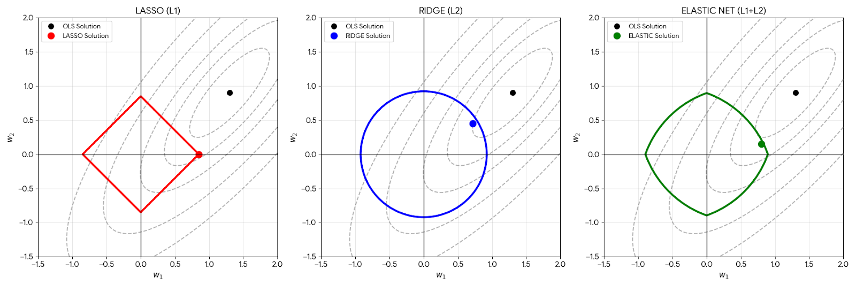
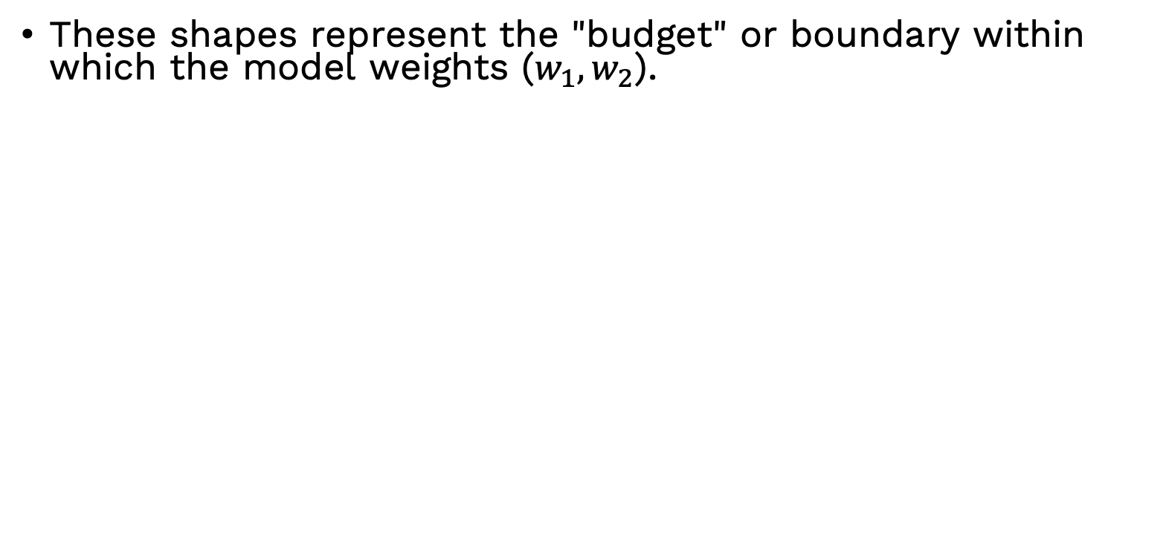
These shapes represent the "budget" or boundary within which the model weights ($w_{1}, w_{2}$).

Slide 15
Feature | Lasso (L1) | Ridge (L2) | Elastic Net
Constraint Shape | Diamond (Pointy) | Circle (Smooth) | Rounded Diamond (Hybrid)
Coefficient Result | Sparse (Many zeros) | Dense (Small values) | Sparse (Zeros allowed)
Best Used When... | You have many useless features. | You have many small, useful features. | You have highly correlated features.

Slide 16
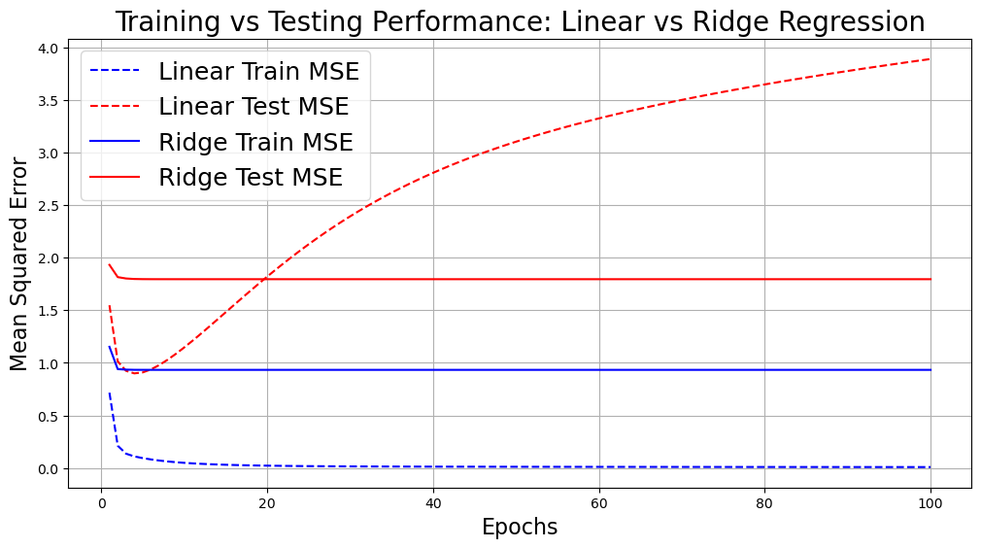
Comparison of Techniques
Techniques | Handles Multicollinearity | Feature Selection | Reduce Overfitting
Simple Regression | No | No | No
Multiple Regression | No | No | No
Ridge Regression | Yes | No | Yes
Lasso Regression | Yes | Yes | Yes
Elastic Net | Yes | Yes | Yes
Overfitting
Notes:
1. Ridge Regression ($L_2$): The "Democratic" Approach
Multicollinearity causes the OLS (standard) model to become "confused," assigning a huge positive weight to one variable and a huge negative weight to its twin to cancel out errors. This leads to unstable coefficients.
How it works: Ridge adds a penalty proportional to the square of the weights ($w^2$).
The Reaction: Instead of letting one variable take all the credit (or blame), Ridge forces the coefficients of correlated variables to be small and similar to each other.
Visual: If "Square Footage" and "Number of Rooms" are highly correlated, Ridge will give them both moderate, stable weights.
2. Lasso Regression ($L_1$): The "Winner-Takes-All" Approach
Lasso is much more "aggressive" when it encounters multicollinearity.
How it works: Lasso adds a penalty proportional to the absolute value of the weights ($|w|$).
The Reaction: Because of the "diamond" shape we discussed earlier, Lasso will typically pick one variable from a group of correlated features and set the others exactly to zero.
Visual: If "Square Footage" and "Number of Rooms" are telling the same story, Lasso will keep "Square Footage" and "kill" "Number of Rooms."

Slide 17
Hands-on

Slide 18
Feature Engineering
Reduce computational time complexity (and memory usage)
Increase interpretability of data
Increase the performance of the model

Slide 19
Methods
Feature Selection
Feature Extraction
Feature Transformation

Slide 20
Feature Selection
A process of selecting a subset of relevant features for use in model construction.
Goal:
  Enhance model performance
  reduce dimensionality of data
  Decrease Training time
  prevent overfitting

Slide 21
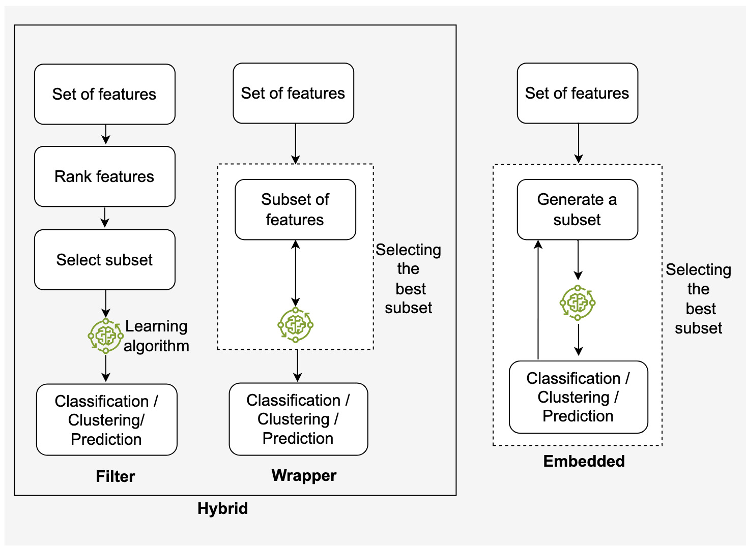
Type of Feature Selection
Filter
  Mutual Information
Wrapper
  Forward Selection
Embedded
  Lasso

Slide 22
Mutual Information
Compute Mutual Information: Calculate the MI between each feature and the target variable
Rank Features: Rank features based on their MI score (higher MI indicates stronger relevance)
Select Top Features: Choose the top k features with the highest MI scores.

Slide 23
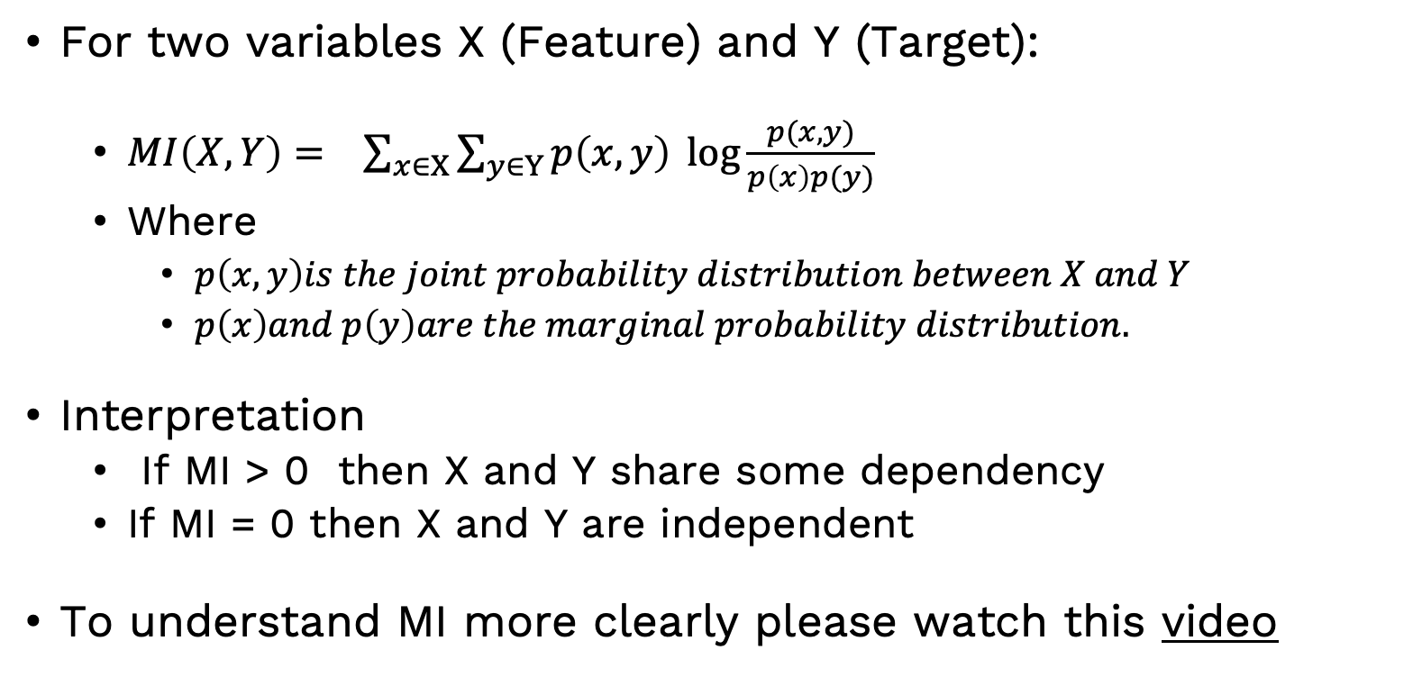
How Mutual Information Works
For two variables X (Feature) and Y (Target):
  $MI\left(X,Y\right)= \sum_{x∈X}{\sum_{y∈Y}{p\left(x,y\right)\log{\frac{p(x,y)}{p\left(x\right)p(y)}}}}$
  Where
    $p\left(x,y\right)is the joint probability distribution between X and Y$
    $p\left(x\right)and p\left(y\right)are the marginal probability distribution.$
Interpretation
  If MI > 0 then X and Y share some dependency
  If MI = 0 then X and Y are independent
To understand MI more clearly please watch this video

Slide 24
Hands-on

Slide 25
Feature Extraction
Aspect | Feature Selection | Feature Extraction
Definition | Selects a subset of the existing features without altering them. | Creates new features by transforming the original data.
Objective | Reduces dimensionality by choosing the most important features. | Captures the most informative aspects of data in a new representation.
Techniques | Filter, wrapper, embedded | PCA, LDA, Autoencoders, …
Nature of features | Works with existing features. | Generates new features that may not directly correspond to original features.
Interpretability | Easy to interpret since it retains original features. | May reduce interpretability as features are transformed or abstract.
When to use | When you want to retain the original features and reduce redundancy. | When transforming data into a lower-dimensional space is needed.

Slide 26
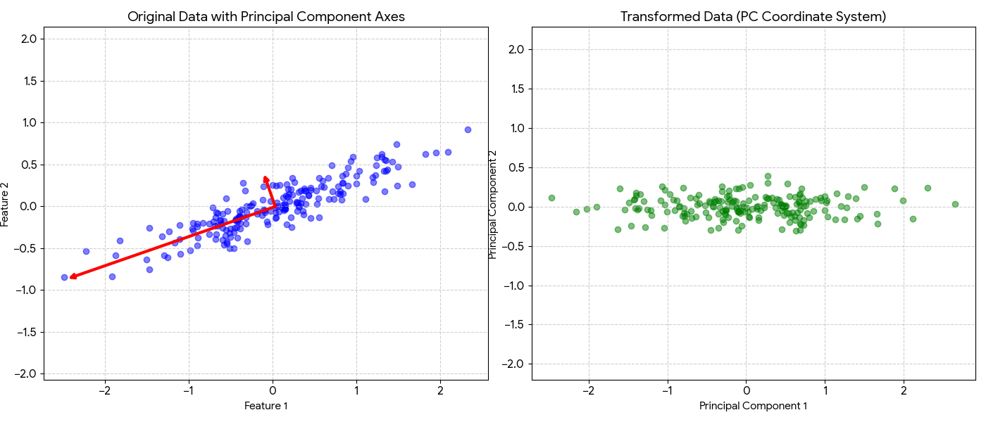
Principal Component Analysis (PCA)
Original Data (Right upper)
The Correlation: The data points form a diagonal "cloud." If Feature 1 increases, Feature 2 typically increases as well.
The Principal Components (Red Arrows): PCA identifies the directions of maximum variance. The longer arrow represents PC1 (the main trend), and the shorter arrow, which is at a 90-degree angle, represents PC2.
Transformed Data (Right lower)
The Rotation: PCA mathematically rotates the entire dataset so that the red arrows become the new x and y axes.
Linear Uncorrelation: Notice that the cloud is no longer diagonal. It is now "squared up" with the grid.
  In this new space, a point's position on Principal Component 1 tells you nothing about its position on Principal Component 2.
  Correlation has been completely removed.
Notes:
PCA is defined as an orthogonal linear transformation that transforms the data to a new coordinate system such that the greatest variance by some scalar projection of the data comes to lie on the first coordinate (called the first principal component), the second greatest variance on the second coordinate, and so on.

Slide 27
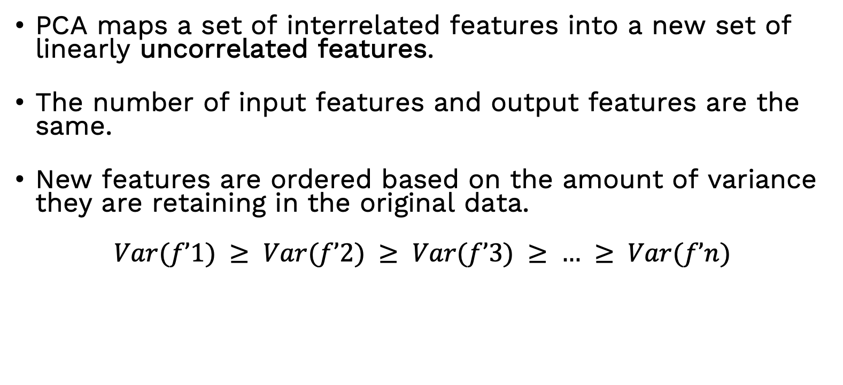
Principal Component Analysis (PCA)
PCA maps a set of interrelated features into a new set of linearly uncorrelated features.
The number of input features and output features are the same.
New features are ordered based on the amount of variance they are retaining in the original data.
$$Var(f’1) ≥ Var(f’2) ≥ Var(f’3) ≥ … ≥ Var(f’n)$$
ID | f1 | f2 | … | fn | Class
1 | 4.3 | 4.9 | … | 4.7 | Healthy
2 | 3.9 | 6.1 | … | 5.5 | Healthy
3 | 2.7 | 4.8 | … | 5 | Healthy
4 | 6.6 | 4.4 | … | 3.9 | Sick
5 | 6.5 | 2.9 | … | 4.6 | Sick
6 | 6.5 | 4.1 | … | 5.5 | Healthy
ID | f’1 | f’2 | … | f’n | Class
1 | 11 | 3 | … | 0.9 | Healthy
2 | 5.4 | 3.5 | … | 1 | Healthy
3 | 1 | 2.7 | … | 0.95 | Healthy
4 | 8 | 2.1 | … | 0.61 | Sick
5 | 7.5 | 2 | … | 0.92 | Sick
6 | 7.5 | 2.5 | … | 1 | Healthy
PCA

Slide 28
PCA
Goals of Principal Component Analysis (PCA)
  Dimensionality Reduction: Reduce the number of features while retaining the maximum amount of variance in the data.
  Eliminate Redundancy: Combine correlated features into fewer uncorrelated components.
  Improve Model Performance: Simplify models by removing irrelevant or less important features.
  Visualization: Help visualize high-dimensional data in 2D or 3D space.
  Preprocessing: Act as a preprocessing step for other machine learning algorithms.

Slide 29
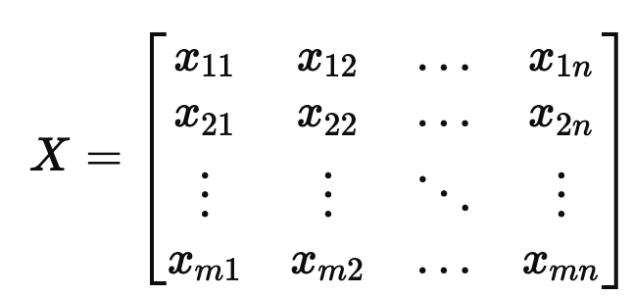
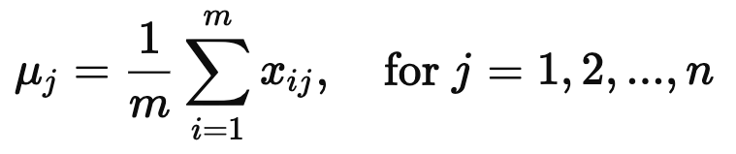
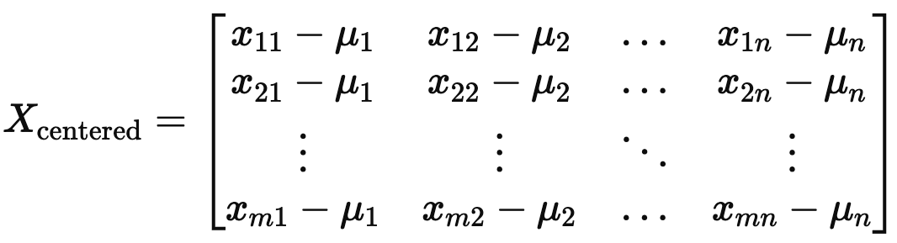
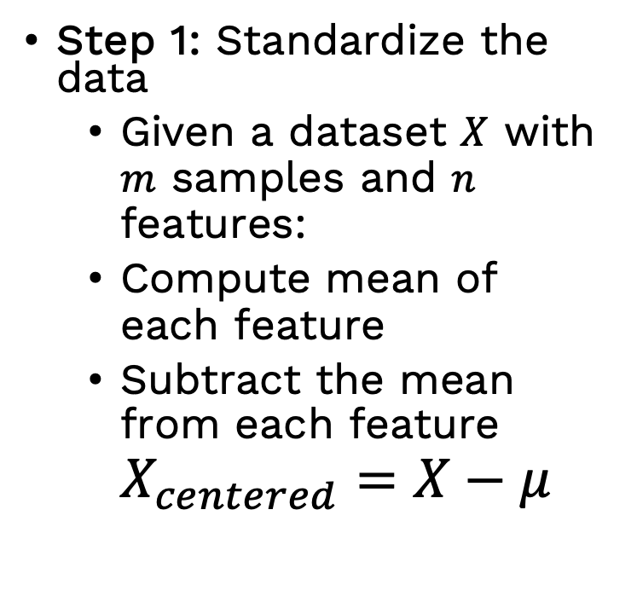
How PCA works ?
Step 1: Standardize the data
  Given a dataset $X$ with $m$ samples and $n$ features:
  Compute mean of each feature
  Subtract the mean from each feature $X_{centered}​=X−μ$

Slide 30
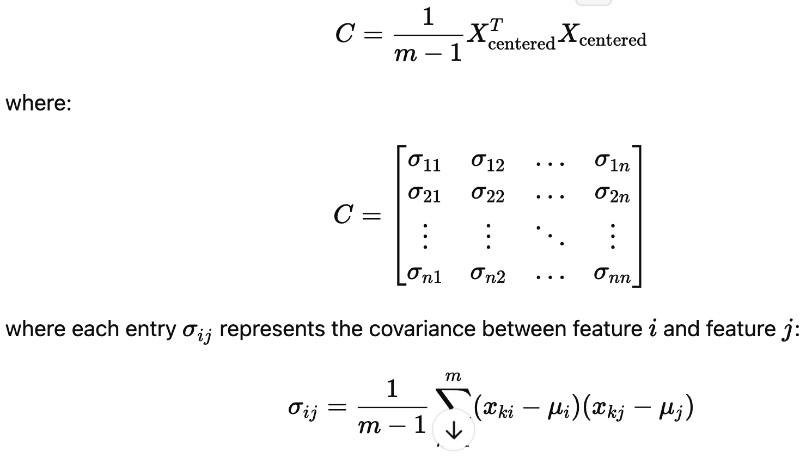
PCA
Step 2: Compute the Covariance Matrix
  The Covariance Matrix describes how different features vary together

Slide 31
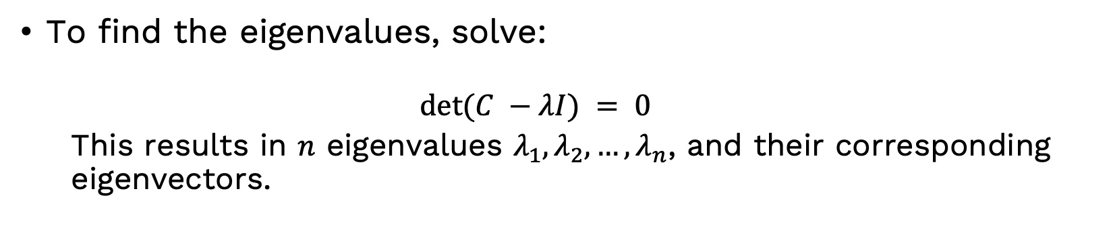
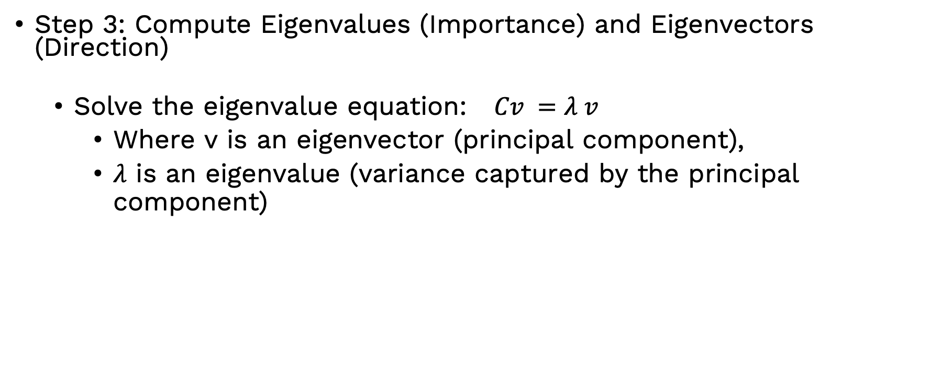
PCA
Step 3: Compute Eigenvalues (Importance) and Eigenvectors (Direction)
  Solve the eigenvalue equation: $Cv =λ v$
    Where v is an eigenvector (principal component),
    $λ$ is an eigenvalue (variance captured by the principal component)
To find the eigenvalues, solve:
  $$det⁡(C −λI) = 0$$
  This results in $n$ eigenvalues $λ_{1}, λ_{2}, …, λ_{n}$, and their corresponding eigenvectors.

Slide 32
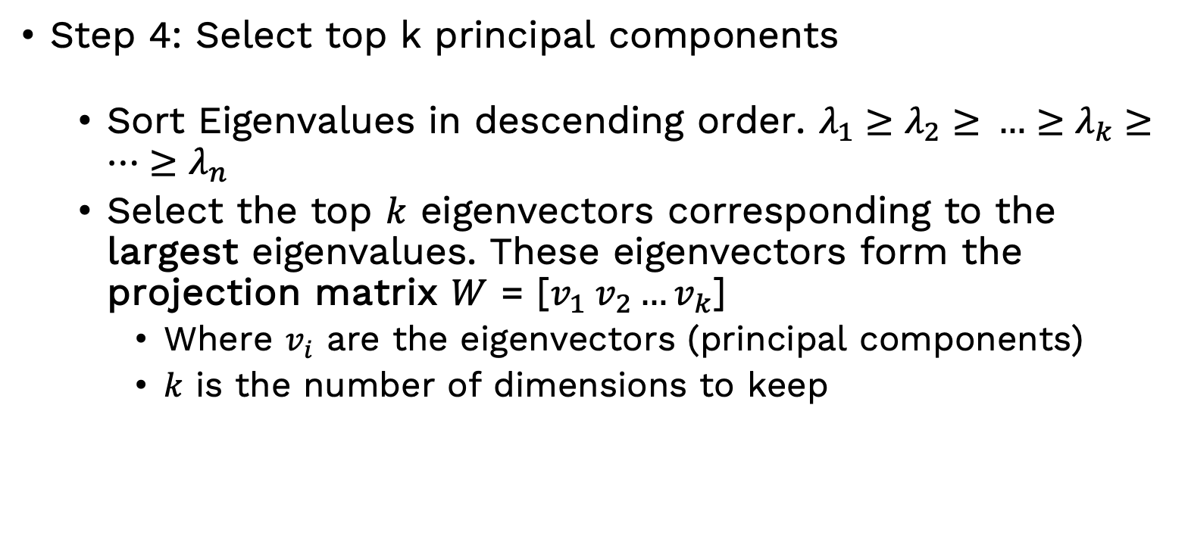
PCA
Step 4: Select top k principal components
  Sort Eigenvalues in descending order. $λ_{1}​≥λ_{2}≥​…≥λ_{k}≥…{≥λ}_{n}$
  Select the top $k$ eigenvectors corresponding to the largest eigenvalues. These eigenvectors form the projection matrix $W$ = [$v_{1} v_{2}…v_{k}$]
    Where $v_{i}$ are the eigenvectors (principal components)
    $k$ is the number of dimensions to keep

Slide 33
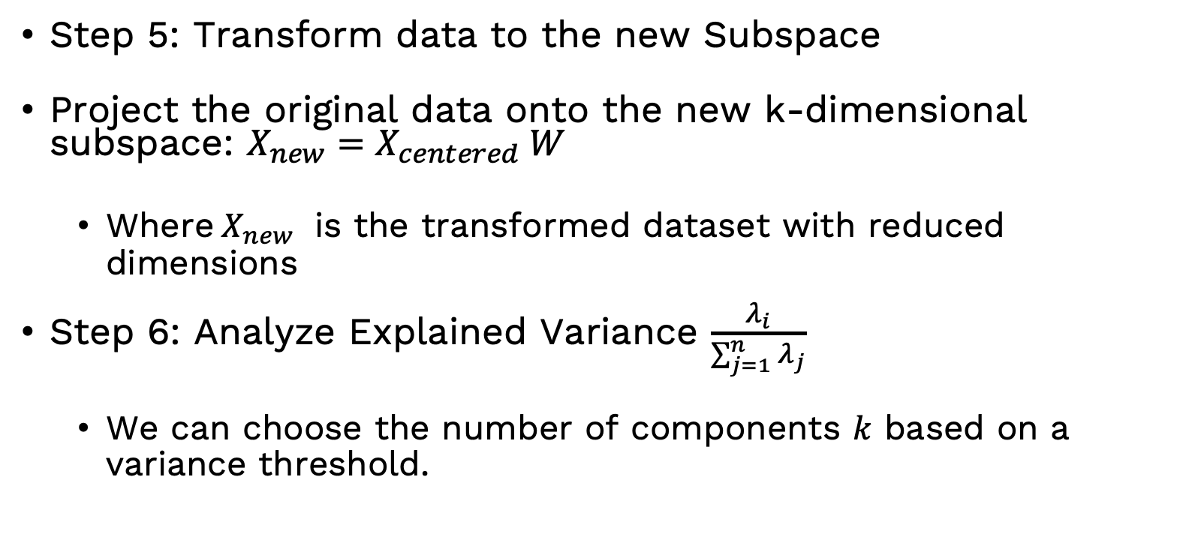
PCA
Step 5: Transform data to the new Subspace
Project the original data onto the new k-dimensional subspace: $X_{new}=X_{centered} W$
  Where$X_{new}$ is the transformed dataset with reduced dimensions
Step 6: Analyze Explained Variance $\frac{λ_{i}}{\sum_{j=1}^{n}{λ_{j}}}$
  We can choose the number of components $k$ based on a variance threshold.

Slide 34
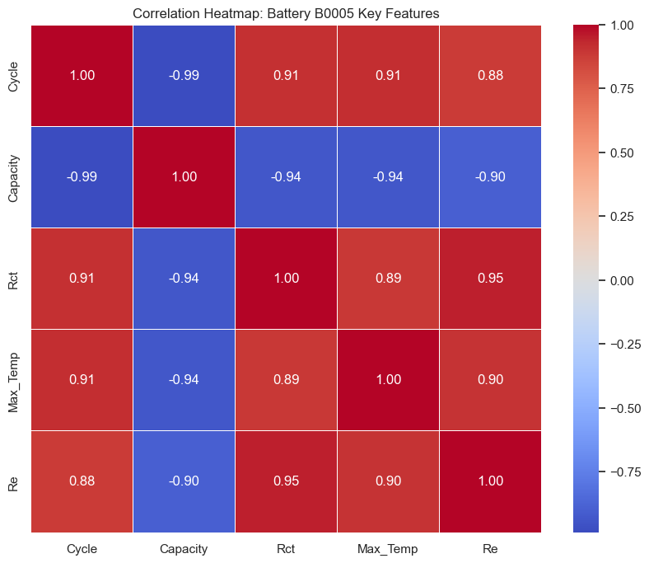
PCA on SOC/SOH
Prediction Goal | Original Correlated Features | PCA's Contribution
SOC | Voltage, Current, Temp | Removes redundancy for faster real-time monitoring.
SOH | Internal Resistance, Capacity Loss | Extracts the dominant "aging signal" from noisy data.

Slide 35
Hands-on

Slide 36
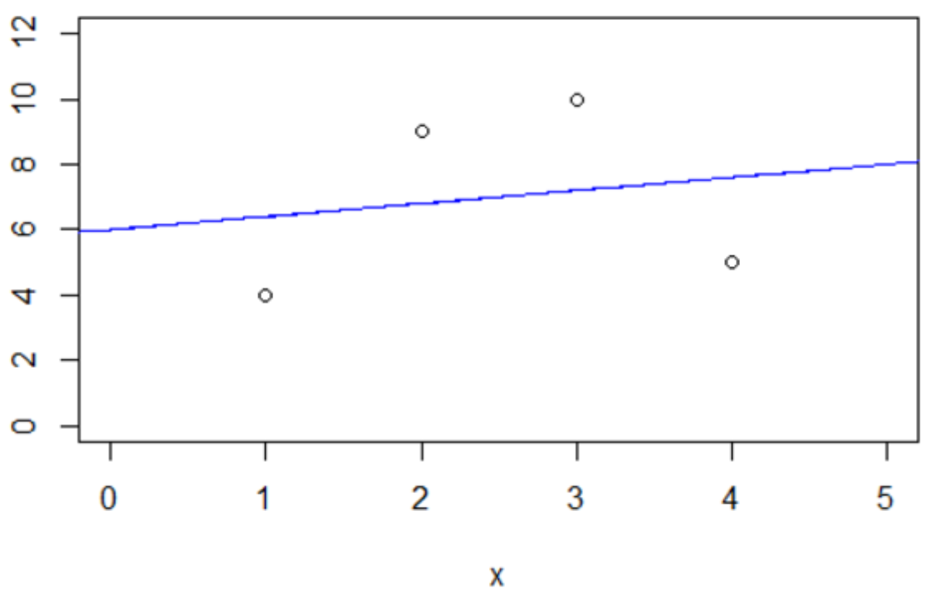
Feature Transformations and Non-linear Features
Feature transformation: converts raw data features into a different scale
Objective is to enhance the learning process.
Methods: normalization, standardization, encoding, and mathematical transformations.
Why Use Non-Linear Features?
  Linear models assume a linear relationship between input features and output.
  Real-world data exhibits non-linearity.
  Transforming features helps the model learn better decision boundaries.
Consider the ordinary least square (OLS) linear regression model (right) generated from the following dataset
X | Y
1 | 4
2 | 9
3 | 10
4 | 5

Slide 37
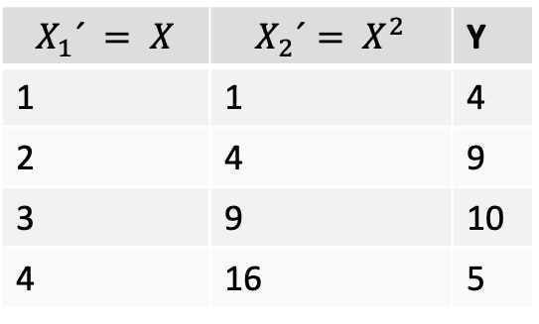
Feature Transformations (Contd.)
X | Y
1 | 4
2 | 9
3 | 10
4 | 5
Feature
Transformation
$$X_{1}´ = X$$ | $$X_{2}´= X^{2}$$ | Y
1 | 1 | 4
2 | 4 | 9
3 | 9 | 10
4 | 16 | 5
We take a non-linear transformation of our features to generate a new, transformed data set

Slide 38
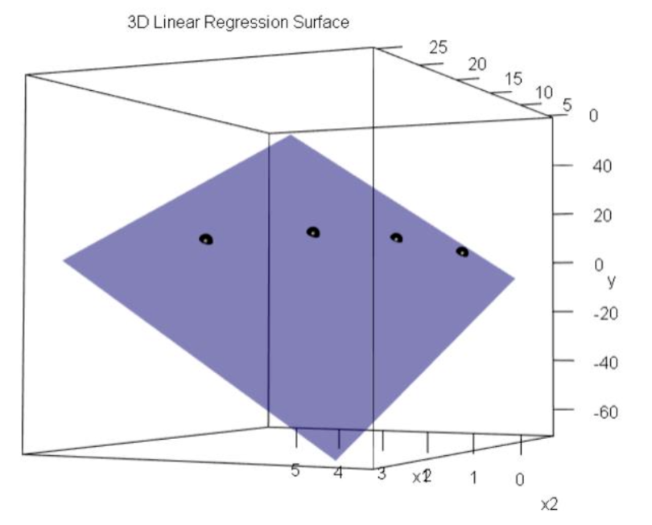
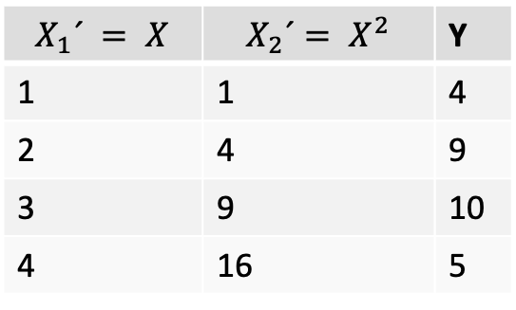
Feature Transformations (Contd.)
Now we make an OLS linear regression model from the new transformed data. The model is, of course, still linear (X' ∈ R2 )
$$X_{1}´ = X$$ | $$X_{2}´= X^{2}$$ | Y
1 | 1 | 4
2 | 4 | 9
3 | 9 | 10
4 | 16 | 5

Slide 39
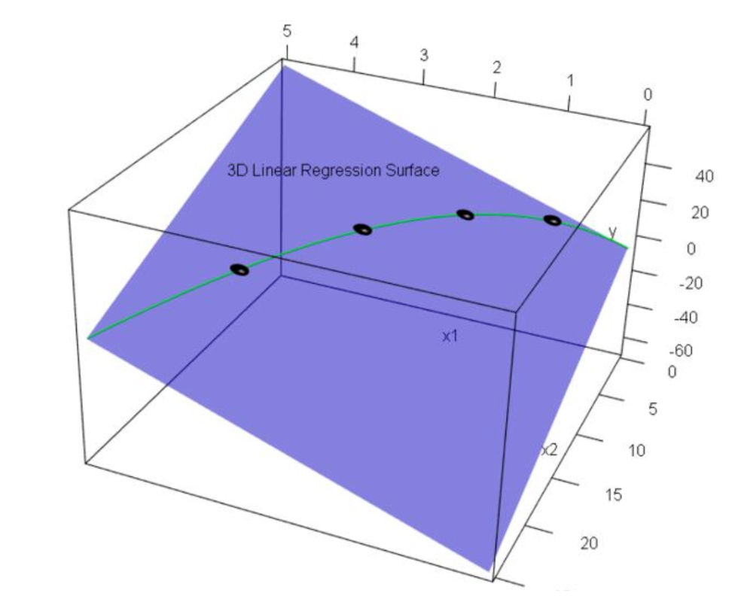
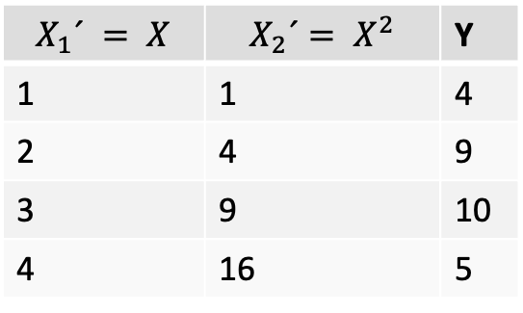
Feature Transformations (Contd.)
Most of the plane represent impossible points.
Only one curve (where X² = X₂') represent possible points.
$$X_{1}´ = X$$ | $$X_{2}´= X^{2}$$ | Y
1 | 1 | 4
2 | 4 | 9
3 | 9 | 10
4 | 16 | 5

Slide 40

Feature Transformations (Contd.)
We can take that curve and plot the X₁' = X vs. Y values into our original two-dimensional space. And we have a non-linear model
X | Y
1 | 4
2 | 9
3 | 10
4 | 5

Slide 41

Polynomial Regression on SOH Prediction

Slide 42
Categorical Variable Encoding
What is Categorical Encoding?
  Machine learning models work with numerical data
  Categorical data must be converted into numerical form
  Different encoding techniques are used to represent categorical variables
Types of categorical variables:
  Nominal: No order (e.g., Color, Gender)
  Ordinal: Has order (e.g., Low, Medium, High)

Slide 43
Categorical Variable Encoding
Label Encoding: Converts each category to a unique integer.
  Example: {'Red': 2, 'Blue': 0, 'Green': 1}
One-Hot Encoding:Converts categorical variables into binary columns.
  Each category becomes a separate column with values 0 or 1.
Fuel consumption | Brand
2.4 | Volvo
3.7 | Toyota
3 | Honda
2.1 | Volvo
Fuel consumption | Volvo | Toyota | Honda
2.4 | 1 | 0 | 0
3.7 | 0 | 1 | 0
3 | 0 | 0 | 1
2.1 | 1 | 0 | 0
Ordinal Encoding (Custom Order): Assigns custom-defined ordinal values to categories.
  Example: {'Blue': 0, 'Green': 1, 'Red': 2}
Target Encoding (Mean Encoding): Replaces a category with the mean of the target variable.

Slide 44
Example
Target Encoding replaces each category with the mean of the target variable for that specific group.
Calculate Mean for Panasonic: (92 + 94) / 2 = 93.0
Calculate Mean for Samsung: 85 / 1 = 85.0
Calculate Mean for LG: 88 / 1 = 88.0
Battery ID | Manufacturer (Category) | SOH (Target %)
001 | Panasonic | 92%
002 | Samsung | 85%
003 | Panasonic | 94%
004 | LG | 88%
Battery ID | Manufacturer (Encoded)
001 | 93.0
002 | 85.0
003 | 93.0
004 | 88.0
Encoded Table

Slide 45
Comparison
Encoding Type | Suitable for | Pros | Cons
Label Encoding | Small categories | Simple | Introduces order
One-Hot Encoding | Nominal variables | No order | High dimensionality
Ordinal Encoding | Ordered categories | Keeps order | Not for nominal
Target Encoding | Large categories | Captures target info | Can cause leakage

Slide 46
Hands-on

